Slide 1


Aum Amriteshwaryai Namaha !
REAL-TIME OBJECT DETECTION AND SELECTION WITHTHE LABVIEW PROGRAM International journal of electrical and computer engineering systems, Vol. 13 No. 8, 2022.
Group No : B9
Student Names : Harshit Kumar,Harshitha N,Pavithra A P,Sanchana P Thomas
Roll Nos: AM.EN.U4ECE22017,AM.EN.U4ECE22123,AM.EN.U4ECE22135,AM.EN.U4ECE22139
19ECE384/19EAC386 Open lab-LabVIEW Programming

Slide 2
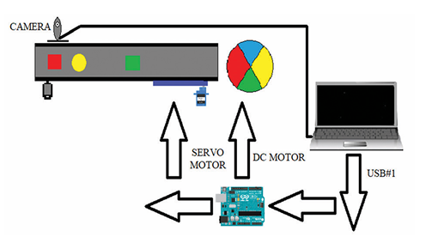


Abstract
Nowadays, the demand for production is increasing due to the increase in the human population. For this reason, different developing technologies are used to meet the required production. In developing technologies, image processing techniques are used to save manpower and time and to minimize possible errors. In this study, image processing techniques were used to detect and select the colors and shapes of the objects coming over the conveyor belt system. Real-time images were preferred in the study. In the implemented system, the selection process was carried out by using the LabVIEW program to define the colors and shapes of the objects. LabVIEW NI IMAQdx was used to find the colors of the objects. To facilitate the definition of shapes, the images taken from the Vision Assistant module in the LabVIEW program were converted to HSL format, and shape definitions were made using different algorithms. After these processes were done, the servo motors in the conveyor belt system were enabled to communicate with each other with the help of the Arduino program and the selection of the objects was carried out. According to the results obtained, the average accuracy rate for three-dimensional objects was 95.349 %. This rate is considered to be a very high rate for object detection of correct color and shape.

Slide 3
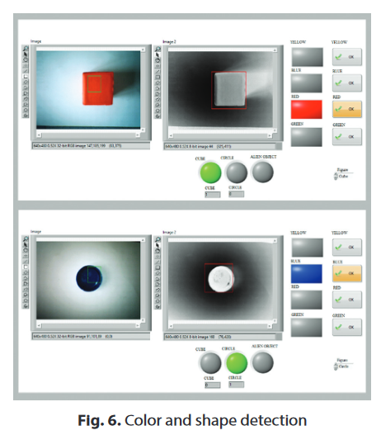
Context of the paper
Basic Theory of the Paper
The core principle of the system is image processing-based object classification and selection in a conveyor belt environment. The system uses:
A webcam to capture real-time images of objects moving on a conveyor.
LabVIEW NI-IMAQdx for color detection and image acquisition.
Conversion from RGB to HSL color space to enhance segmentation and color distinction.
Vision Assistant algorithms for shape detection (e.g., centroid calculation, pattern matching).
Servo motors controlled by Arduino (via LINX interface) to sort the detected objects based on their color and shape.
The system uses fixed thresholding and rule-based classification for object identification. While effective under stable conditions, it lacks adaptability to environmental variability.
Application Domain
Industrial Automation: The system is designed for automated sorting in manufacturing and production lines, where objects must be categorized quickly and accurately based on visual characteristics.
Agricultural Processing: Similar image processing techniques have been used for sorting tomatoes, measuring fruit size (apples, oranges, lemons), and detecting defects.
Quality Control: The model can be extended to detect product defects, surface flaws, or sort based on quality parameters.
Educational & Research Labs: Demonstrates the use of LabVIEW and Arduino integration for real-time embedded image processing applications.
International journal of electrical and computer engineering systems, Vol. 13 No. 8, 2022.

Slide 4
Objectives of the paper
Old system
To design and implement a real-time object detection and selection system using LabVIEW, capable of identifying colors and shapes of moving objects on a conveyor belt system, and then sorting them using Arduino-controlled servo motors.
Performance Parameters:
Average Accuracy: 95.349% for correct color and shape detection of 3D objects.
Objects Detected: 4 colors (Red, Blue, Yellow, Green), 2 shapes (Cube, Circle).
Camera Used: USB webcam (640×480 resolution).
Color and Shape Detection: Done via HSL color space and shape algorithms in LabVIEW.
Sorting Mechanism: Controlled via Arduino + Servo Motors using LINX interface.
Lighting Sensitivity: Accuracy affected under poor lighting conditions.
Source: Pamuk, Nihat. "Real-time object detection and selection with the LabVIEW program", International Journal of Electrical and Computer Engineering Systems, Vol. 13, No. 8, pp. 661–668, 2022.
New System
To design a simple, cost-effective, and real-time object detection system using LabVIEW for waste sorting—without relying on AI or ML—using template matching for identifying objects based on shape and color.
Performance Parameters:
Detection Accuracy:
Achieved 94% accuracy under stable lighting conditions.
Compared to Pamuk et al.’s 95.34% system which included Arduino-based actuation.
Similarity Threshold:
Objects are considered a match when the similarity score (based on normalized cross-correlation) is ≥ 0.85.
Detection Time:
Ranged from 138 ms to 187 ms, depending on lighting conditions.
Lighting Sensitivity:
Performs best under bright and medium light.
Lower similarity scores (e.g., 0.52) in flickering or dim light led to mismatches.
Matching Method:
Template matching using LabVIEW’s Vision Assistant and IMAQ Match Pattern VI.

Slide 5
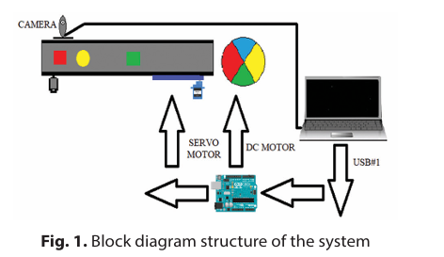
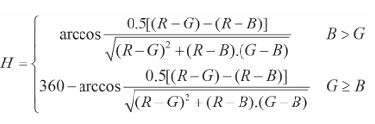

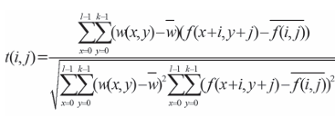
Methodology
Old System:
Calculations:
1.HSL Conversion from RGB:
2. Z-value mapping (intensity scaling)
3. Normalized Cross-Correlation (for shape matching):
Block diagram description:
Image Acquisition: via webcam (IMAQ USB drivers)
Color Detection: using NI-IMAQ Color Learn
Shape Detection: using Vision Assistant, RGB → HSL
Object Selection: based on predefined thresholds
Sorting: via Arduino-controlled servo motors

Slide 6
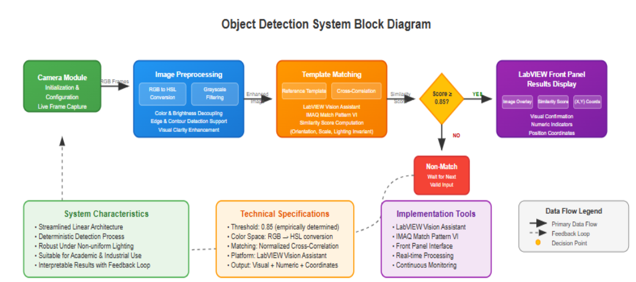
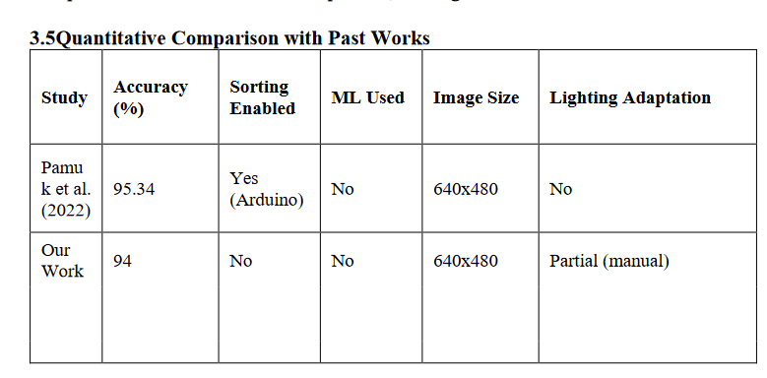
Methodology continuation… if needed
New System:
Description of steps:
Image Acquisition: Webcam via LabVIEW NI-IMAQdx
Image Preprocessing includes RGB to HSL conversion and grayscale filtering to enhance image clarity and support edge detection.
Template Matching compares the enhanced image with a reference template using cross-correlation and calculates a similarity score.
If the similarity score ≥ 0.85, the result is displayed on the LabVIEW Front Panel with image overlay, similarity score, and coordinates.
If the score is below the threshold, it waits for the next valid input, ensuring accuracy and robustness under varying lighting conditions.

Slide 7
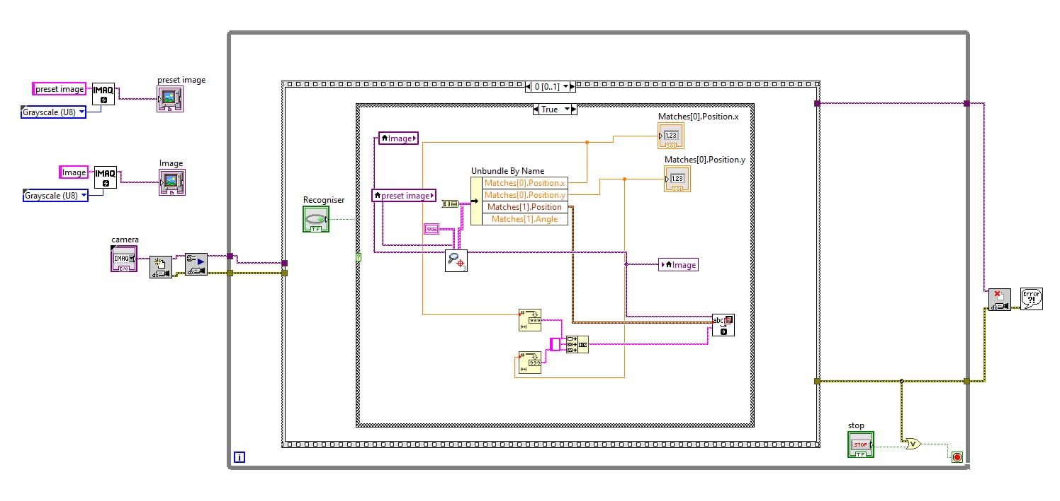
Results
BLOCK DIAGRAM

Slide 8
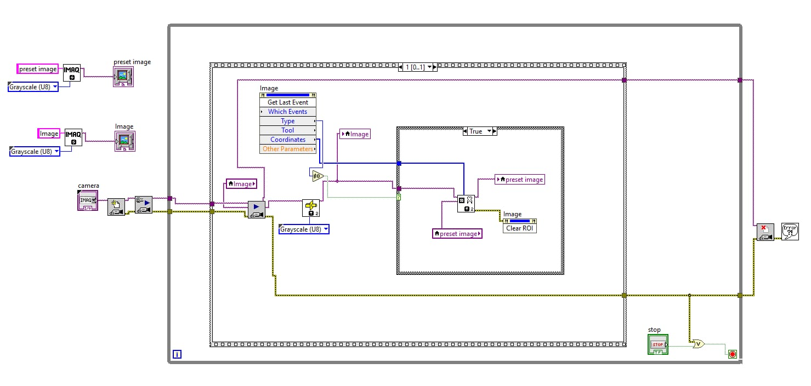
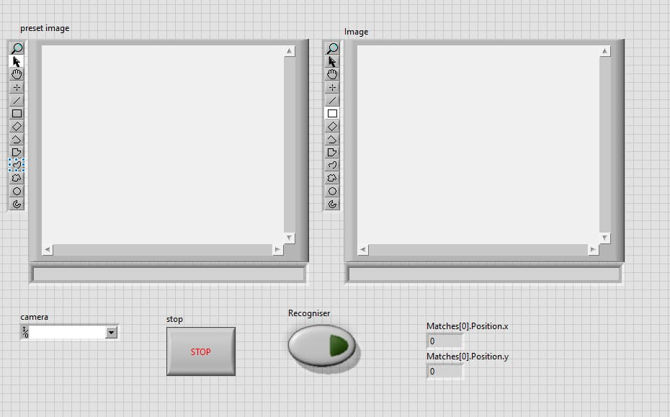
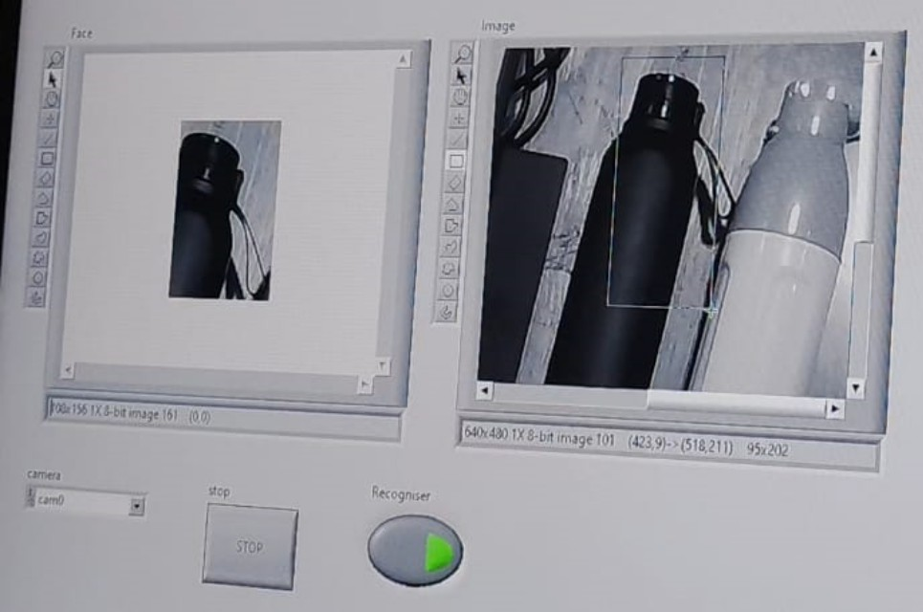
Front Panel
BLOCK DIAGRAM
Hardware setup

Slide 9
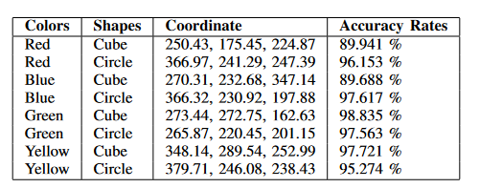
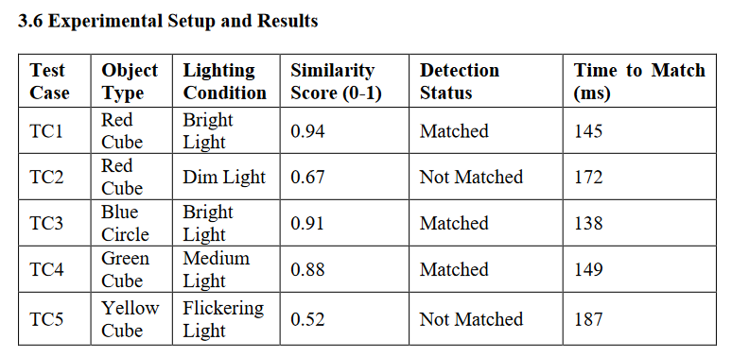
Results continuation…
PAPER RESULT
OUR RESULT
The simulation results are not the same because they measure different aspects of the system:
Paper assesses real-time detection behavior under varied lighting.
Our work evaluates overall system accuracy and localization precision across object types.
These differences provide a complementary view of system performance—both are necessary to fully validate the object detection system.
This data reflects real-time test cases under different lighting. This system works well under stable lighting, but struggles under dim/flickering light, revealing a dependency on consistent illumination-unlike more advanced systems.

Slide 10
Contribution from each member
Harshit Kumar- AM.EN.U4ECE22017- Region of interest setup logic
Harshitha N –AM.EN.U4ECE22123-Camera Interfacing , Pattern matching and similarity
Pavithra A P- AM.EN.U4ECE22135- Region of interest setup logic
Sanchana P Thomas-AM.EN.U4ECE22139-Testing the result, Pattern matching and similarity

